Slide 1
Plant &Body Systems
Cells, Tissue, Organ, System

Slide 2
The Cell
Schleiden and Schwann gave us the first three traditional Cell Theory; 4-6 were included as fact:
Cells are the basic unit of life.
All living things are made up of cells.
All cells come from pre-exisiting cells by division.
Cells contain hereditary information which is passed from cell to cell during cell division.
All cells are basically the same in chemical composition.
All energy flow (metabolism & biochemistry) of life occurs within cells

Slide 3
The Hierarchy: in plants
Systems: Dermal Tissue, Ground Tissue, and
Vascluar Tissue System
Tissues form one of three Systems
Cells form to make Tissue

Slide 4
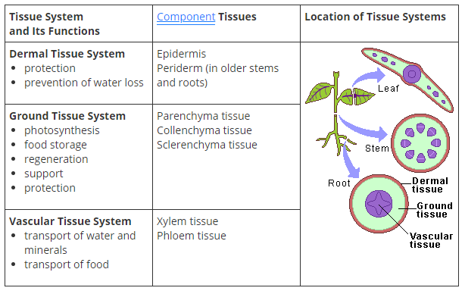
Vascular plants
Vascular plants have two distinct organ systems: a shoot system and a root system.
The shoot system consists of two portions: the vegetative (non-reproductive) parts of the plant, such as the leaves and the stems, and the reproductive parts of the plant, which include flowers and fruits.

Slide 5
Vascular plants
Stomata-slits in the epidermis of leaves, stems, etc., through which gases are exchanged.
Xylem-a compound tissue that helps provide support and conducts water and nutrients upward from the roots, consisting of tracheids, vessels parenchyma cells, and woody fibers.
Phloem-the part of a vascular bundle consisting of sieve tubes, companion cells, parenchyma, and fibers and forming the food-conducting tissue of a plant.

Slide 6
Transpiration & Photosynthesis
Transpiration is the process by which moisture is carried through plants from roots to stomata on the underside of leaves, where it changes to vapor and is released to the atmosphere.
The function of transpiration is two-fold: cooling the plant and pumping water and minerals to the leaves for photosynthesis.
Photosynthesis is the process by which plants convert light energy to food
6CO₂ + 6H₂0 + light energy C₆H₁₂0₆ + 6O₂
Carbon dioxide + water + light energy glucose (sugar) + Oxygen
Can you explain how to balance this equation?

Slide 7
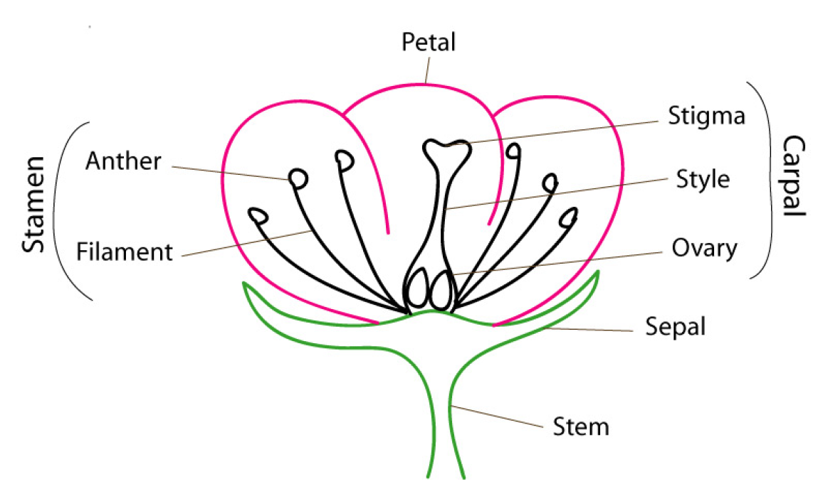
Flower dissection lab
Like humans, plants have male and female parts in their reproductive system
In this lab, you will be able to identify the following:
The ovule where the ovaries are contained, is called the pistil.

Slide 8
The Hierarchy: In Humans
Systems: Circulatory, Digestive, Endocrine,
Exocrine, Immune, Muscular, Nervous, Excretory,
Reproductive, Respiratory, Skeletal
Organs work with other organs to function as a system
Tissues form to make Organs
Cells form to make Tissue

Slide 9
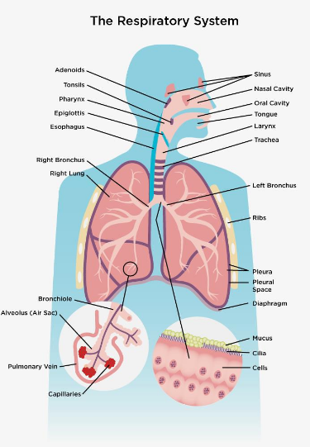
The Respiratory System
The primary organs of the respiratory system are the lungs, which carry out the exchange of gases as we breathe.
The red blood cells collect the oxygen from the lungs and carry it to the parts of the body where it is needed
This is a nice example of how the systems work together. The blood is also part of the circulatory system
*image courtesy of the Lung Association

Slide 10
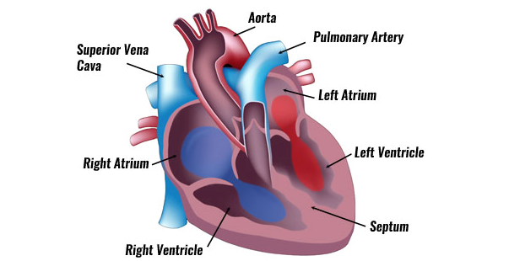
The circulatory system
The circulatory system is a vast network of organs and vessels that is responsible for the flow of blood, nutrients, hormones, oxygen and other gases to and from cells.

Slide 11
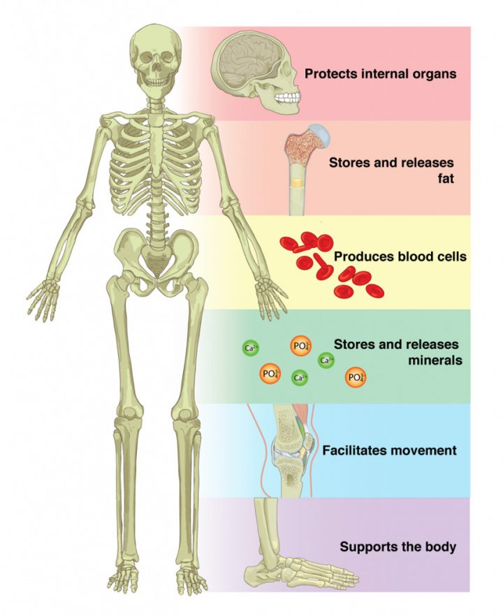
The Skeletal system
The skeletal system is the body system composed of bones, cartilage, ligaments, and other tissues that perform essential functions for the human body.
Our bones provide support, movement (with help from the soft tissue like cartilage and ligaments, and muscles) and protection of some inner organs.
Metabolically, our bones also provide mineral (calcium and phosphorus) storage, and store some lipids and fatty acids in our yellow marrow; while producing blood in the red marrow (hematopoiesis).
*image courtesy of Oregon State-Open Textbook/Anatomy & Physiology

Slide 12
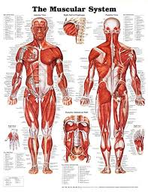
The Muscular system
The muscular system is an organ system consisting of skeletal, smooth, and cardiac muscles.
It permits movement of the body, maintains posture and circulates blood throughout the body.

Slide 13
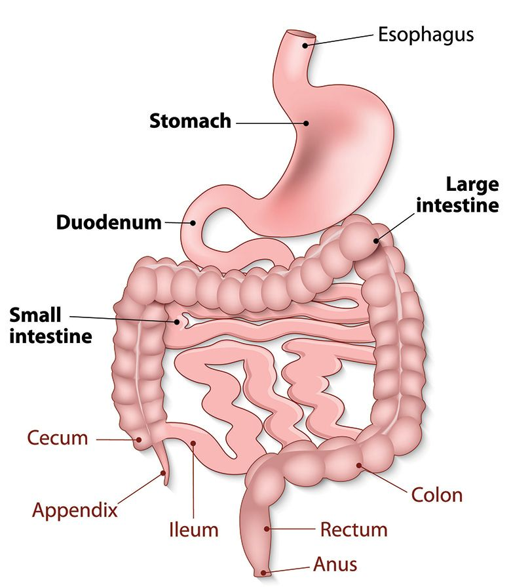
The Digestive System
The digestive system is a group of organs working together to convert food into energy and basic nutrients to feed the entire body.
Food passes through a long tube inside the body known as the alimentary canal or the gastrointestinal tract (GI tract).
The GI tract is an organ system within humans and other animals which takes in food, digests it to extract and absorb energy and nutrients, and expels the remaining waste as feces.

Slide 14
The nervous & endocrine systems
The nervous system is a network of nerve cells and fibers which transmits nerve impulses between parts of the body.
The endocrine system is a messenger system consisting of hormones to regulate function of target organs to maintain homeostasis.
Homeostasis is having a relatively stable equilibrium. In simple terms, when you are dehydrated, your equilibrium is off. You need water to balance the electrolytes in your system; or athletes who require Gatorade to replenish their electrolytes when they lose them through sweat.

Slide 15
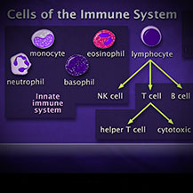
The immune system
The Immune system is the body’s defense against infectious organisms and other invaders.
I’ll go over this better when I get back.

Slide 16
The Exocrine system

