Slide 1
DNA and the birth of Molecular Forensics
Back in the Day; the CSI effect;

Slide 2
Back in the Day
In the early 1960’s, scientists believed it was protein that carried the genetic information in our bodies.
Alfred Hershey and Martha Chase proved it was actually DNA that carried the genetic information.
James Watson and Francis Crick, with the help of Maurice Wilkins and Rosalind Franklin, were credited with identifying the double helix structure of DNA.
Although there is still some controversy, all three men were awarded the Nobel Prize, leaving out Rosalind Franklin from any recognition for many years.

Slide 3
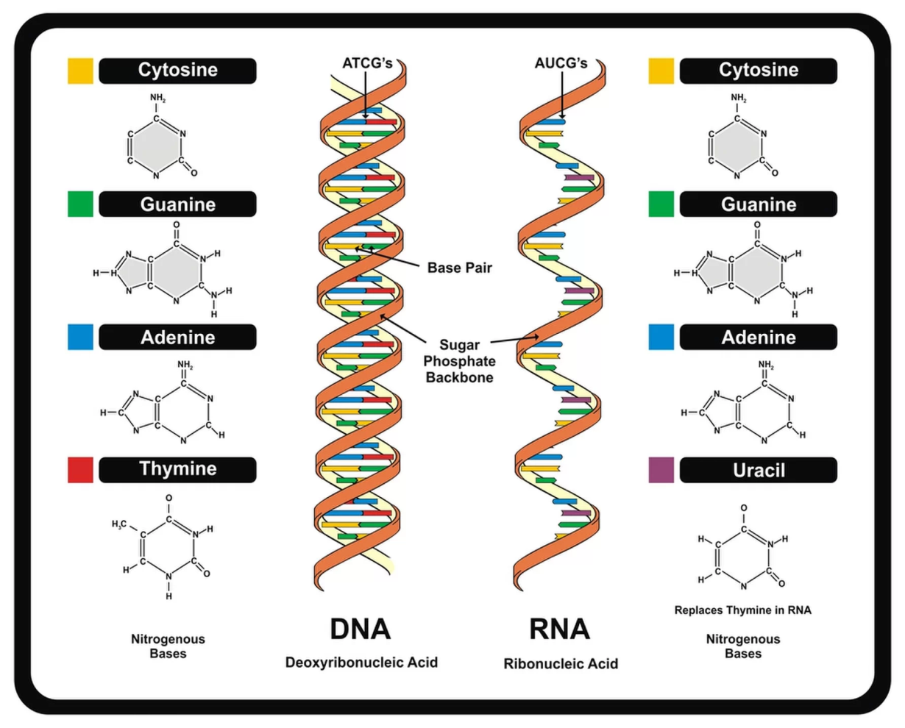
The Make-Up
DNA, also known as deoxyribonucleic acid, carries the genetic information in our cells.

Slide 4
The Make-Up
Adenine, thymine, guanine, and cytosine are the nitrogenous base pairs that are held together by the sugar-phosphate backbone creating the double helix structure.
DNA is replicated through a process called mitosis. In the nucleus of the cell the DNA separates, creating two strands of chromosomal DNA (cDNA).
Free RNA nucleotides make copies of these strands, by base pairing C-G and A-U. The messenger RNA (mRNA) strand is send out of the nucleus, through the endoplasmic reticulum, to be translated into amino acid chains which link together to become protein.

Slide 5
DNA Replication
DNA replication is the synthesis of new DNA from existing DNA.
The process of Polymerase Chain Reaction (PCR) was first developed in academia and was of use to forensic scientists interested in gene identification.
In PCR, small quantities of DNA or broken pieces of DNA found in crime scene evidence can be copied with the aid of a DNA polymerase and cycling, thermal technology.
Denaturing-95⁰C separates the double stranded DNA
Annealing-varies (56⁰C-62⁰C) recombines the single strands with nucleotides (like in transcription)
Extension-72⁰C copies of the DNA are extended and replicated

Slide 6
Restriction Fragment Length Polymorphism (RFLPs)
Geneticists have discovered that portions of the DNA molecule contains sequences of letters that are repeated many times. These repeating sequences, or tandem repeats, seem to act as filler or spacers between the coding regions of DNA.
Restriction Fragment Length Polymorphisms (RFLPs) are cut out of the DNA double helix by a restriction enzyme, which acts like a pair of scissors.
In 1985, Sir Alec Jeffreys used this technology to prove the innocence of one man, and guilt another.

Slide 7
Random Amplified Polymorphic DNA (RAPD)
In 1992, a woman’s body was discovered in a remote location in Maricopa County. The road to this area was lined with Palo Verde Trees, native plants in the Sonoran Desert. As investigators were assessing the scene, they heard a pager beeping.
The pager belonged to Mark Bogan of Phoenix. When investigators tracked him down, he explained the woman was an acquaintance of his the evening before. He claimed she tried to steal his wallet from the dashboard of his truck and must have taken his pager when he caught her.

Slide 8
Random Amplified Polymorphic DNA (RAPD)
Although the victim was with Mr. Bogan, and his pager was found at the scene of the crime, investigators were able to secure a search warrant with this circumstantial evidence.
Upon revisiting Mr. Bogan, his truck had been recently cleaned inside and out, with the exception of two Palo Verde seed pods in the back of truck, between the cab and the bed.
Remembering one of the Palo Verde trees near the scene of the crime had a broke branch, the lead investigator collected the seed pods.

Slide 9
Random Amplified Polymorphic DNA (RAPD)
Not knowing if a match could be made between the pods and the parent tree, the Sheriff contacted a plant geneticist at the University of Arizona.
Dr. Tim Helentjaris was instrumental in mapping the corn genome years prior. Dr. Helentjaris offered his assistance, and devised a suitable plan of attack.
Because mapping the genome of desert flora was not a priority for research, no one knew what genes they had. Unlike RFLP, where you know what genes you are looking at, Random Amplified Polymorphic DNA (RAPD) analysis uses random sequences of DNA; therefore, not requiring the need to know what genes are present.

Slide 10
Random Amplified Polymorphic DNA (RAPD)
Because the suspect claims to never have been at or near the area where the body was found, this evidence was used to disprove his claim.
A total of 100 Palo Verde seed pods were collected from various trees near and around the location of the crime scene. Using RAPD analysis, a genetic match was made between the seed pods and the parent tree.
This is a landmark case; the first time ever where plant DNA was used in a murder trial.

