Slide 1
Biomes,Ecosystems, and Environments
Habitats, Limiting factors, and dislocation

Slide 2
Biomes
A biome is a complex biotic community characterized by distinctive plant and animal species and maintained under the climatic conditions of the region.
Within each biome are ecosystems that have adapted, evolved and thrived over time and have acclimated to the conditions of that biome: climate, average rainfall, dewpoint, and temperature, cultures of the populations (people), music, etc.
Review the notes I gave you on my weebly to make your biome brochure (be creative and have fun with it!)

Slide 3
What is our ecosystem? What is our environment in this ecosystem?
An ecosystem is a system, or group of interconnected elements formed by the interaction of a community of organisms with their environment.
An ecosystem is built upon the relationships within the organisms of a population and its interactions with other populations.
A population is all the individuals of one species in a given area (i.e. humans, scorpions, coyotes, rabbits, hawks, etc.).
A community is an assemblage of interacting populations occupying a given area.
An environment includes the air, water, minerals, organisms, and all other external factors surrounding and affecting a given organism at any time. (Understand what abiotic and biotic mean.)
A habitat is the natural environment of an organism; place that is natural for the life and growth of an organism.

Slide 4
Interactions
Food web: a series of organisms related by predator-prey and consumer resource interactions; the entirety of interrelated food chains in an ecological community.
Decomposer: an organism, usually bacterium or fungus, that breaks down the cells of dead plants and animals into simpler substances (think minerals).
Producer: an organism, as a plant, that is able to produce its own food from inorganic substances (think photosynthesis).
Primary consumer: an animal that feeds on plants; an herbivore
Secondary consumer: a carnivore that only feeds upon herbivores
Tertiary consumer: a carnivore that feeds on other carnivores.
Quaternary consumer: the final consumer/omnivore- can feed on other carnivores, herbivores, plants.

Slide 5
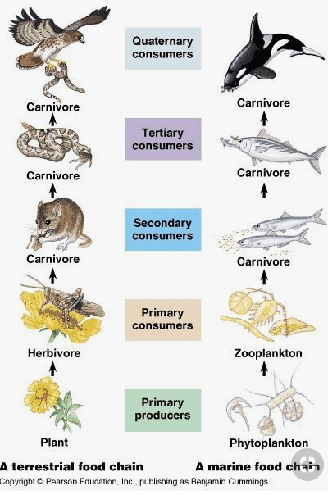
Interactions
Food Chain: a series of organisms interrelated in their feeding habits, the smallest being fed upon a larger one, which in turn feeds a still larger one, etc.
While food webs and food chains may seem similar, keep in mind food webs reference their particular ecosystems, and completes the web of life by including decomposers.

Slide 6
Relationships
Commensalism: a type of relationship between two species in which one lives with, on, or in another without damage to either. (i.e. orchids growing on branches of trees; barnacles and whales)
Mutualism: a relationship of species of organisms in which both benefit from the association. (i.e. The oxpecker (a type of bird) on the rhinoceros or zebras. They eat the ticks and other parasites on the animals’ skins, and the animals get pest control.
Parasitism: a relation between organisms in which one lives off another. (i.e. flea/ticks and dogs; desert mistletoe and mesquites).
The predator-prey relationship relies on one species hunting another for food. Scavengers are often those that eat the “leftovers,” but are still considered predators because they will hunt if needed.

Slide 7
10% Rule of Energy states the amount of energy at each trophic level decreases as it moves through the ecosystem.
0.1%
1%
10%
100%
Courtesy of Texas Gateway online resource

Slide 8
Limiting Factors of an Ecosystem
Limiting factors are environmental conditions that limit the growth, abundance, or distribution of an organism or a population of organisms in an ecosystem.
Density dependent limitations include disease, competition, and predation. Density dependent factors may influence the size of the population by changes in reproduction or survival. Food availability and density combine to limit growth, resulting in both negative and positive effects.
Density independent limitations include food, predation, and other density dependent factors. Environmental stresses affect population growth, and are often abiotic such as food or nutrient limitation, pollutants in the environment, and climate extremes, including monsoons, hurricanes, fires, and other castastrophes.

Slide 9
Urban Sprawl
Urban sprawl is the uncontrolled spread of urban development into neighboring regions.
How do you think the construction of the Rosemont Mine is like urban sprawl? In addition to the local human populations, what other organisms will be affected by this mine? Use your thoughts to help you with your paper.

Slide 10
Adaptation
A change or the process of change by which an organism or species becomes better suited to its environment.
Thinking of the wild animals that will be displaced because of the Rosemont Mines, do you think they will be able to adapt to their new environments?
The correct answer should be, it depends. Why is that? Take some time to think about this answer and write it down on a piece of paper and turn it in.

