Slide 1
Fingerprints
Early classification; Fundamental Principles; Automated Fingerprint Identification Systems (AFIS)

Slide 2
Early Classification
Several years before Bertillon worked on his system, William Herschel started requiring signatures using the a person’s right hand print in India.
It was unclear why he did this. It may have been as a means of identification, but per Hindu custom, a trace of bodily contact was more binding than a signature on a contract.
In 1880, Scottish physician Henry Fauld, published his views on the potential application of fingerprinting to personal identification.
  He suggested that skin ridge patterns could be important for the identification of criminals

Slide 3
Early Classification
Early in the 20th century, Bertillon’s measurements began to fall into disfavor, because the results were highly susceptible to error, especially if the person taking the measurements was untrained.
The system was dealt its most notable setback in 1903, when a convict, Will West, arrived at Fort Leavenworth prison. A routine check of the prison files revealed a William West was already in the prison and could not be distinguished from the new prisoner. The two men looked so alike, they could have been twins. Only fingerprints of the prisoners could clearly distinguish them.

Slide 4
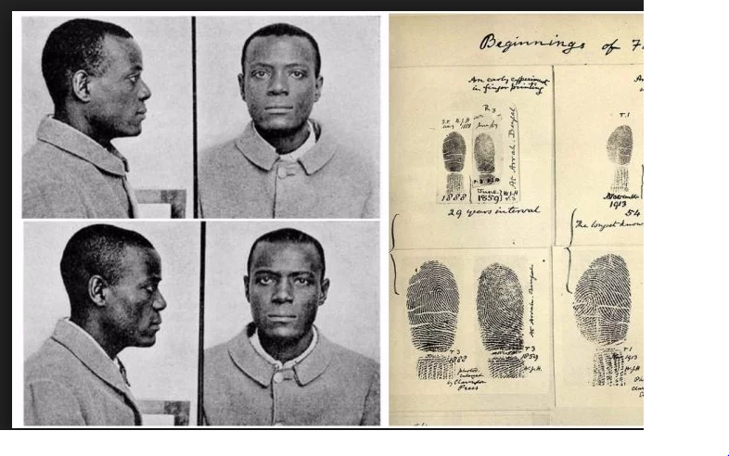
Early Classification
https://www.google.com/search?q=1903+william+west&tbm=isch&source=iu&ictx=1&fir=m_KlpahkVLvDiM%253A%252CmLAYTb40mHSnvM%252C_&usg=AFrqEzfp8LTDrkRI1kBQyFp-vif3J-b4tw&sa=X&ved=2ahUKEwiCtIOk9YTdAhULwFQKHd7zCP8Q9QEwBHoECAMQBg#imgrc=SdJNeQtGGqAUTM:

Slide 5
Fundamental Principles
First Principle: A fingerprint is an individual characteristic; no two fingers have yet been found to possess identical ridge characteristics.
Ridge characteristics (minutiae) include: ridge endings, bifurcations, enclosures, and other ridge details, which must match in two fingerprints to establish their common origin.

Slide 6
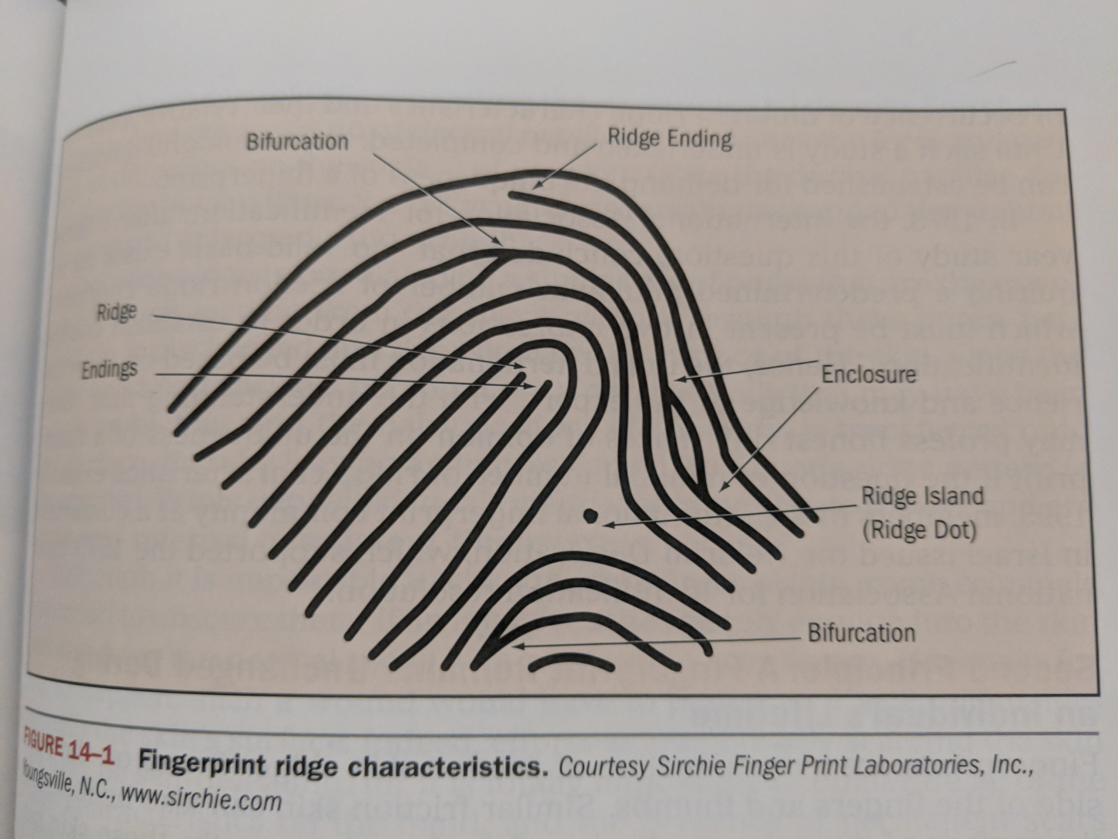
Fundamental Principles

Slide 7
Fundamental Principles
Second Principle: A fingerprint remains unchanged during an individual’s lifetime.
  Fingerprints are a reproduction of friction skin ridges found on the palm side of the fingers and thumbs. Similar friction skin can also be found on the surface of the palms and soles of the feet.
  A visual inspection of friction skin reveals a series of lines corresponding to hills (ridges) and valleys (grooves). The shape and form of the skin ridges are what one sees as the black lines of an inked fingerprint impression.
  Latent fingerprints are made by the deposition of oils and/or perspiration and are invisible to the naked eye.

Slide 8
Fundamental Principles
Third Principle: Fingerprints have general ridge patterns that permit them to be systematically classified.
  All fingerprints are divided into three classes on the basis of their general pattern: Loops, whorls, and arches.
  60%-65% of the population have loops; 30%-35% have whorls; and about 5% have arches.
  These three classes form the basis for all the ten-finger classification systems presently in use.

Slide 9
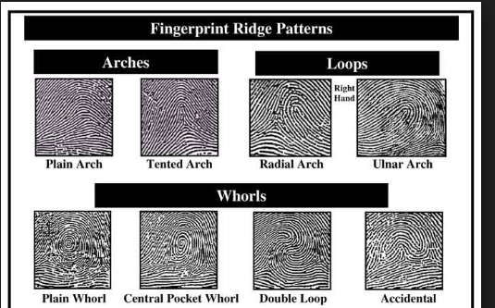
Fundamental Principles

Slide 10
Fundamental Principles
Loop: Loops must have one or more ridges entering from one side of the print, recrving, and exiting from the same side. If the loop opens towards the little finger, it is called an ulnar loop; if it opens toward the thumb, it is a radial loop.
  The pattern area of the loop is surrounded by two diverging ridges known as type lines.
  The ridgepoint at or nearest the typ-linedivergence and located at or directly in front of the point of divergence is know as the delta.
  The core is the approximate center of the pattern.

Slide 11
Fundamental Principles
Whorls are actually divided into four distinct groups: plain, central pocket loop, double loop, and accidental. All whorl patterns must have two type lines and at least two deltas.
  A plain whorl and a central pocket loop have at least one ridge that makes a complete circuit. This ridge may be in the form of a spiral, oval, or any variant of a circle.
  The double loop is made up of two loops combined into one fingerprint.
  Any whorl classified as an accidental either contains two or more patterns (not including the plain arch) or is a pattern not covered by other categories.

Slide 12
Fundamental Principles
Arches are subdivided into two distinct groups: plain arches and tented arches.
  The plain arch is the simplest of all fingerprint patterns; it is formed by ridges entering from one side of the print and exiting on the opposite side.
  The tented arch is similar to the plain arch except that instead of rising smoothly at the center, there is a sharp upthrust or spike, or the ridges meet at an angle that is less than 90 degrees.
  Arches do not have type lines, deltas, or cores.

Slide 13
Automated Fingerprint Identification Systems (AFIS)
Since 1970, technological advances have made possible the classification and retrieval of fingerprints by computers.
In 1999, the FBI initiated full operation of the Integrated Automated Fingerprint Identification system (IAFIS), the largest AFIS in the United States, which links state AFIS computers with the FBI database.
The heart of AFIS technology is the ability of a computer to scan and digitally encode fingerprints so they can be subject to high-speed computer processing.

Slide 14
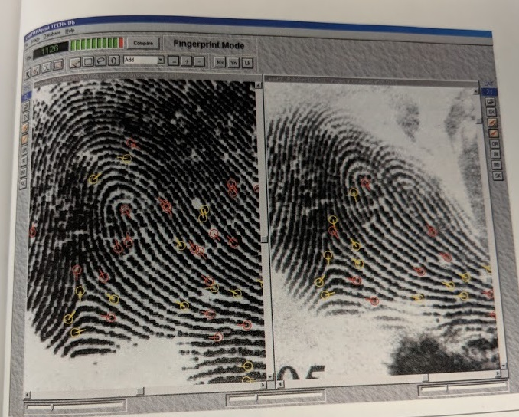
AFIS
Side by side comparison of latent print against a file fingerprint
AFIS and the Night Stalker; Please listen as I read and tell a story about my friend’s encounter with Richard Ramirez.

