Slide 1
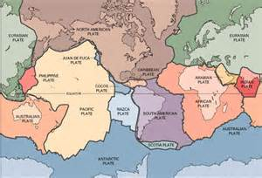
Geographical Plate Boundaries
What happens when plates move in different directions?

Slide 2
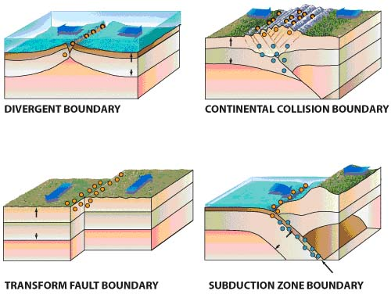
Types of Plate Boundaries
https://www.youtube.com/watch?v=dXDYoCqwSbM#t=13

Slide 3
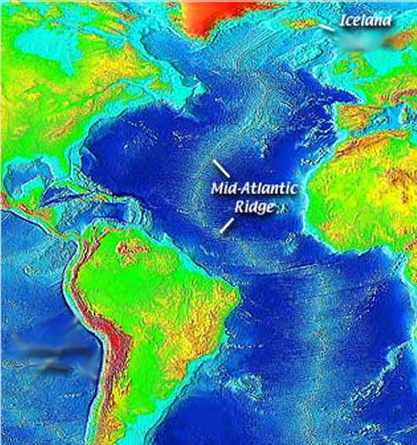
Mid-Atlantic Ridge
Divergent
Between the North & South American and the African & Eurasian Plates!

Slide 4
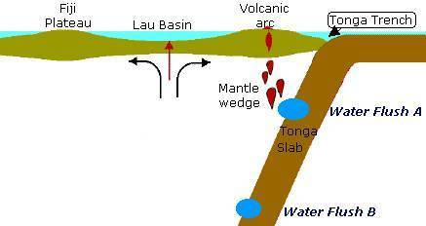
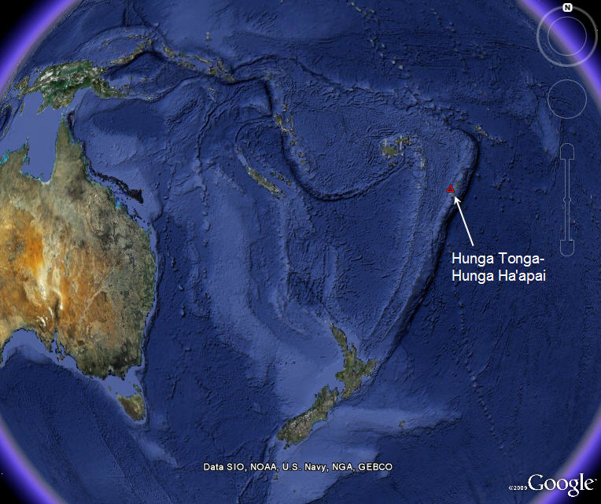
Tonga Trench
Convergent
Between the Pacific & the Indo-Australian Plates!

Slide 5
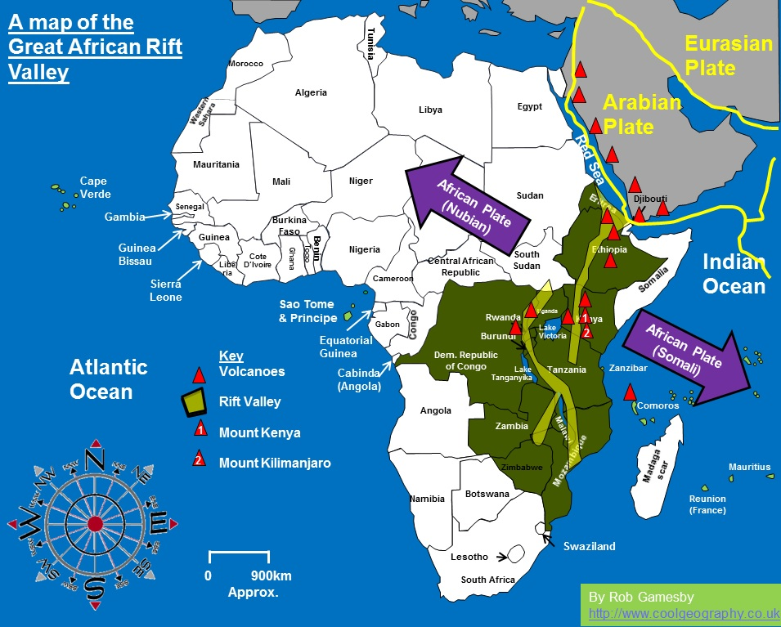
East African / Great Rift Valley
Divergent
Between the relatively new Nubian & Somalian Plates (w/in the African Plate)!

Slide 6
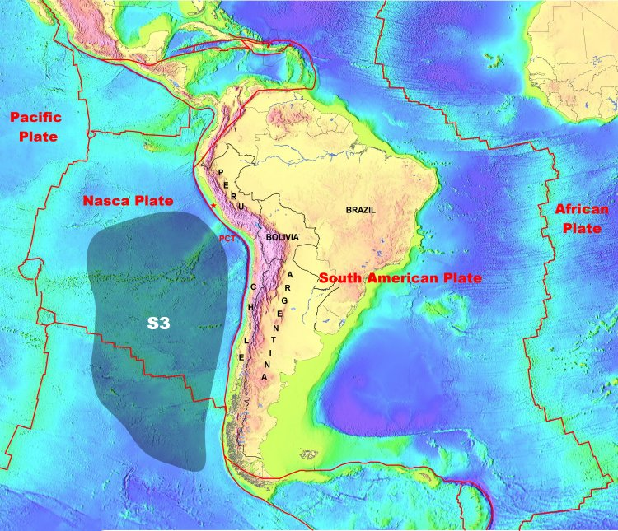
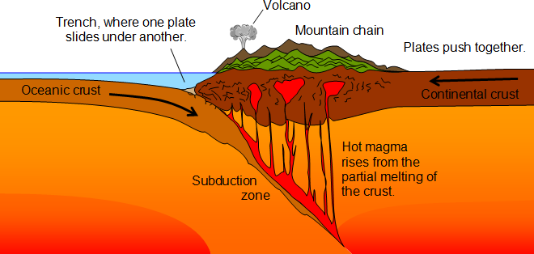
Peru-Chili Trench
Convergent
Between the Nazca & South American Plates!

Slide 7
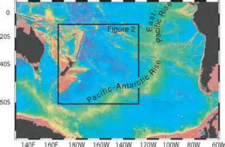
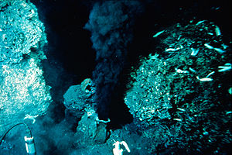
East Pacific Ridge (Rise)
Divergent
Between the Pacific & both the Nazca and Antarctic Plates!
Volcanic heat vents support life at the sea floor!

Slide 8
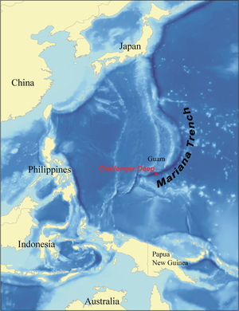
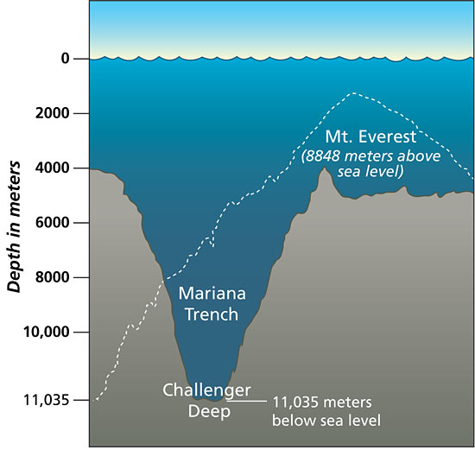
Mariana Trench
Convergent
Between the Philippine and Pacific Plates!

Slide 9
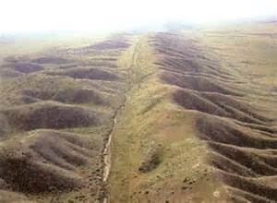
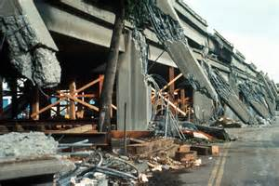
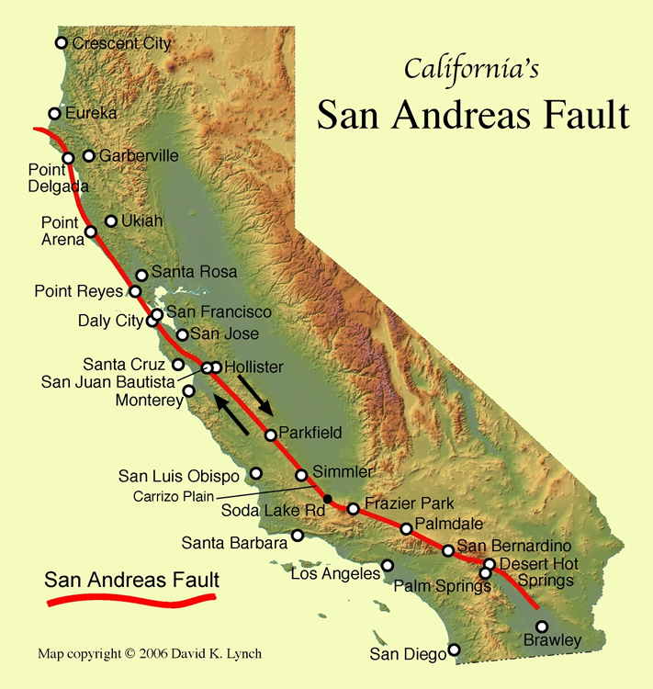
San Andreas Fault
Transform
Between the Pacific& North American Plates!
San Francisco, 1989

Slide 10
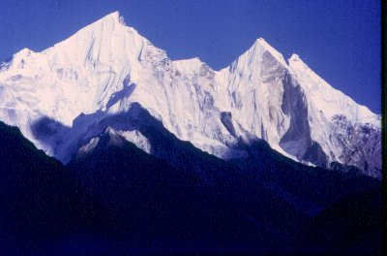
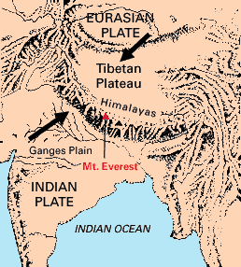
Himalaya Mountains
Convergent
Between the Indo-Australian & Eurasian Plates!

Slide 11
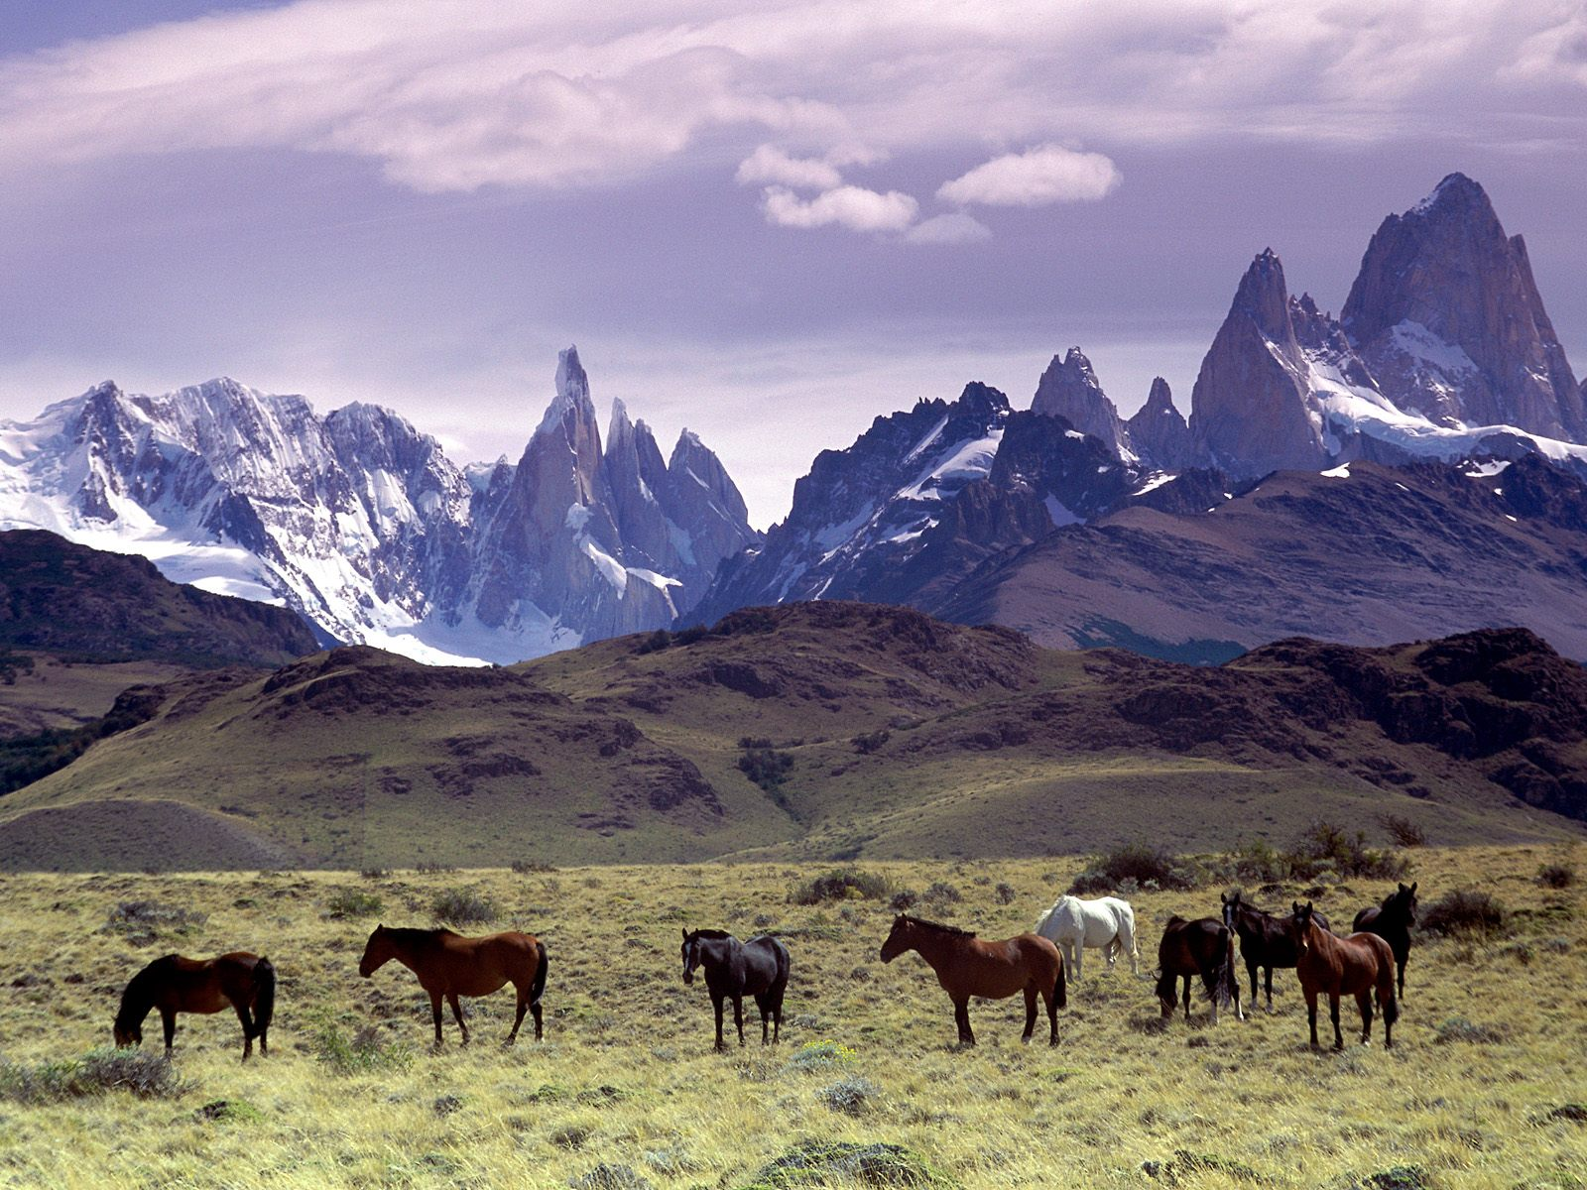
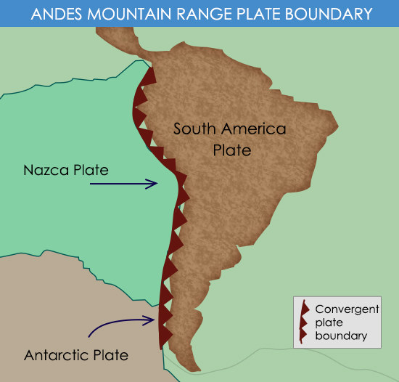
Andes Mountains
Convergent
Between the Nazca & South American Plates!

Slide 12
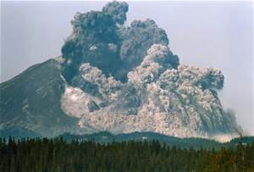
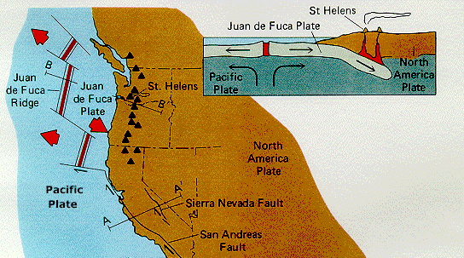
Cascade Mountains
Mt. St. Helens
Convergent
Between the North American & the Juan de Fuca Plates!

Slide 13
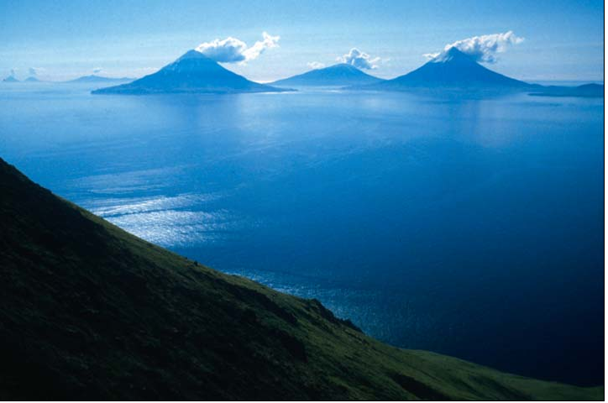
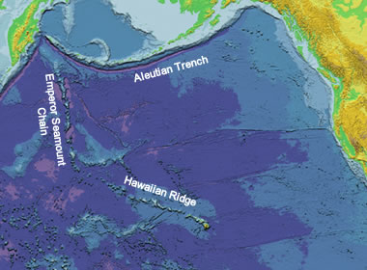
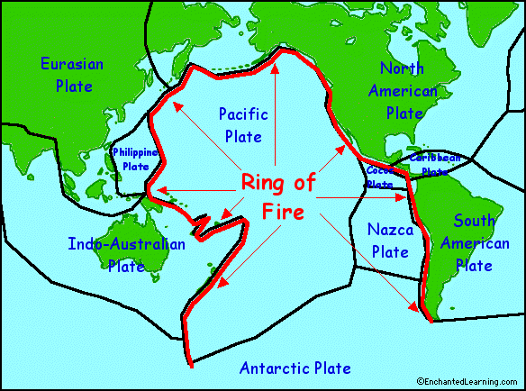
Aleutian Trench
Convergent
Between the North American & Pacific Plates!
Island Volcanoes
Part of The Ring of Fire!

Slide 14
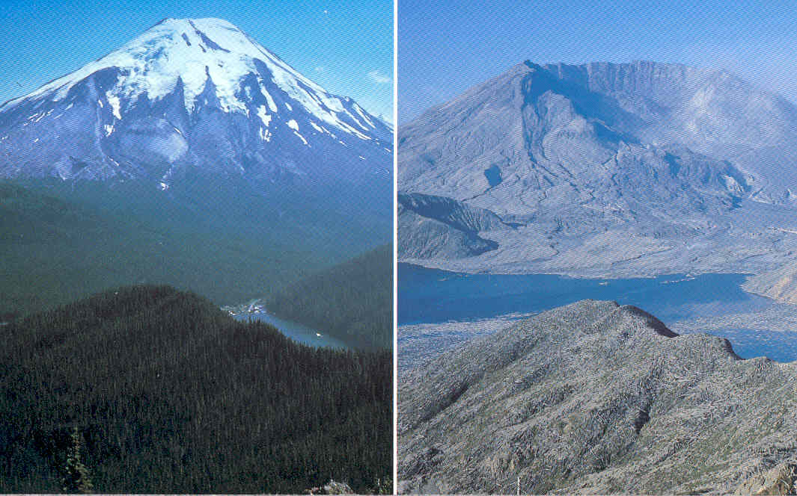
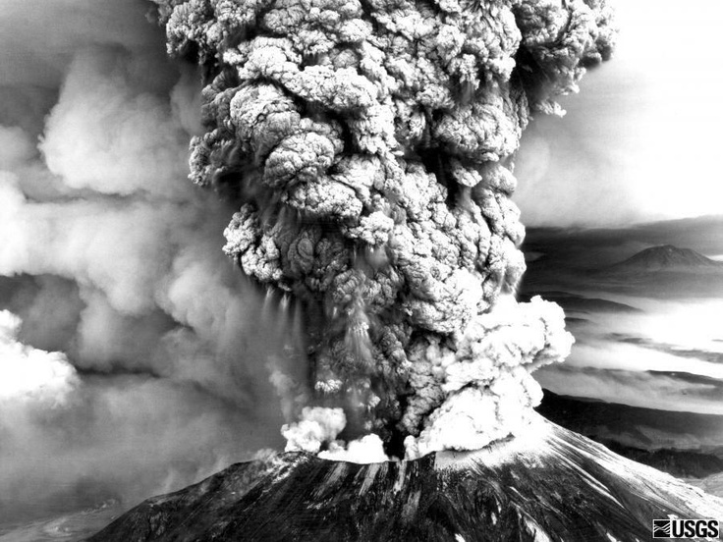
Mt. St. Helens
Convergent
Part of the Cascades
Between the N. American and Juan de Fuca Plates!
Before & After

