Slide 1
The Richard F. Caris Mirror Lab
At the University of Arizona

Slide 2
Overview: From the Beginning
The Richard F. Caris Mirror Lab is a world leader in creating giant mirrors for telescopes around the world.
The rather than making conventional solid-glass mirrors, the Mirror Lab developed a honeycomb structure on the inside, upholding the borosilicate glass used for the paraboloid structure. Honeycomb mirrors offer the advantages of their solid counterparts –rigidity and stability, but they can be significantly larger and dramatically lighter.
In 1980, Dr. Roger Angel, the lab’s founder and scientific director, tried an experiment testing the suitablitiy of borosilicate glass (the kind used for making ovenware) for making honeycomb structures.

Slide 3
Overview: From the Beginning
To make these honeycomb structures, he tested the idea by fusing together two custard cups in an improvised kiln. He succeeded.
He continued with this experiment, using bigger kilns and small furnaces, and eventually spin casting mirrors 1.8 meters in diameter.
By 1985, and with the help of grants from the US Airforce, the National Science Foundation and the University of Arizona, the lab began increasing the size of their mirror to 3.5 meters.
By 1992, they cast the largest mirror at 6.5 meters; then in 1997, the molds casted the largest mirror at 8.4 meters (essentially the size of this room.

Slide 4
Giant Magellan Telescope (GMT)
https://www.gmto.org/
The GMT will be one of the next class of super giant earth-based telescopes that promises to revolutionize our view and understanding of the universe. It will be located in Chile.
The GMT will have 7 mirrors, 6 off axis and 1 central, forming a single optical surface with collecting area of 24.5 meters, or 80 feet in diameter.
The GMT will have resolving power 10 times greater than the Hubble Space Telescope.

Slide 5
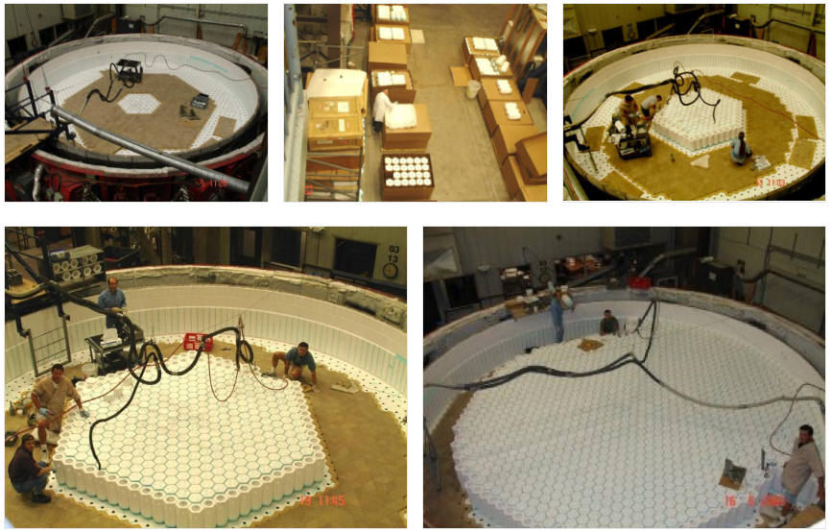
The Process
Step 1: Casting
As scene in the photo below, the honeycomb structures are cast into their designated areas.

Slide 6
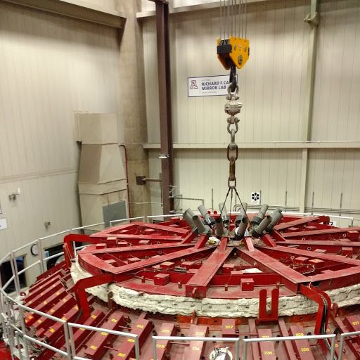
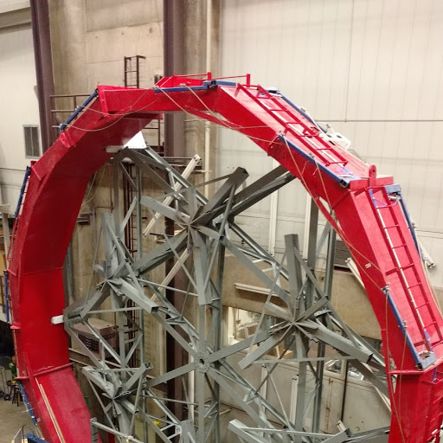
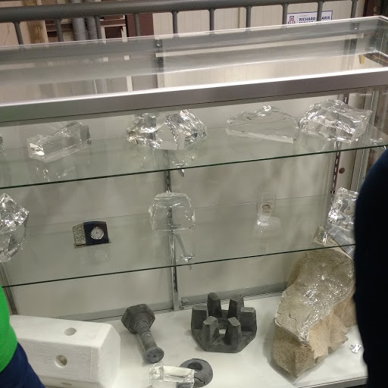
The Process
Step 2: Grinding
Special glass from Japan, Ohara E6-type borosilicate, is broken and ground over the honeycomb cast.
It is then melted, molded and spun cast into the shape of a paraboloid in a custom designed rotating oven.

Slide 7
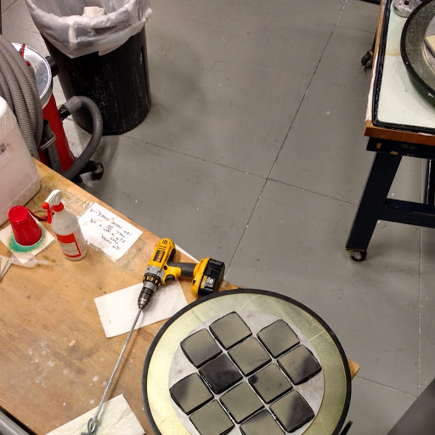
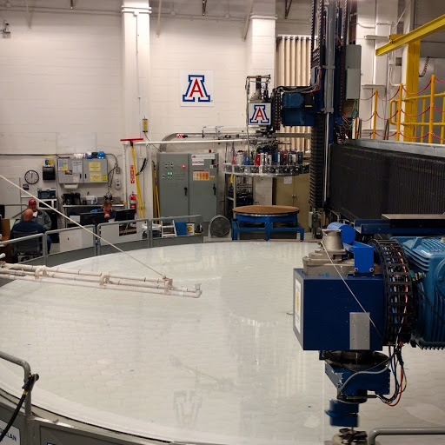
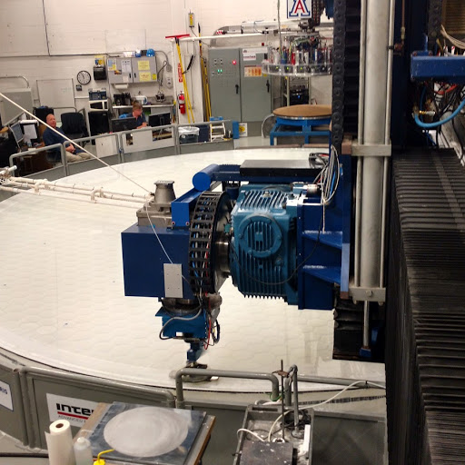
The Process
Step 3: Polishing
After the mirror is cast, it has to cool before it can be removed. This will take about 3 months. Yes, it’s that big and that hot.
Once the mirror is removed, diamond crusted pads are used to smooth and polish the glass.

Slide 8
LSST
The Large Synoptic Survey Telescope is a new kind of telescope. It can detect faint objects with short exposures. Its uniquely wide field of view allows it to observe large areas of the sky at once; compact and nimble, it can move quickly between images.
Taking more than 800 panoramic images each night, it can cover the sky twice each week.
A powerful data system will compare new with previous images to detect changes in brightness and position. Hundreds of images of each part of the sky will be used to construct a movie of the sky. This “movie” can potentially be viewed to track and detect hazardous asteroids that might have a disastrous impact on earth.

Slide 9
Lsst
Data from the LSST will be used to create a 3D map of the Universe, and can be use to locate dark matter and characterize properties of dark energy.
Plans for sharing the data from LSST with the public are as ambitious as the telescope itself.
Anyone with a computer will be able to access the data and potentially make their own discoveries.

