Slide 1
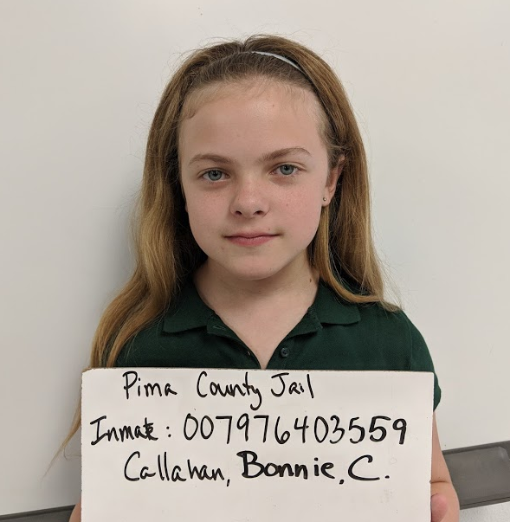
Pima County Jail, Tucson AZ
Offenses Date
Theft, pencils 8/26/15
Noise infraction 8/30/15
Fraud, false testimony 10/1/15
Fraud, false testimony 1/24/16
Fraud, false testimony 5/25/17
Fraud, false testimony 6/18/17
Fraud, false testimony 7/19/17
Theft, 2/25/18
Noise infraction 5/5/18

Slide 2
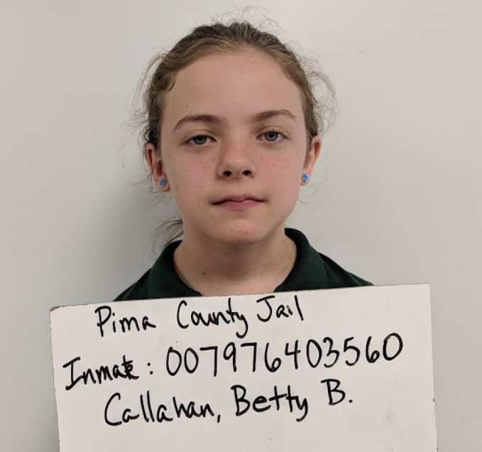
Pima County Jail, Tucson AZ
Offenses Date
Theft, pencils 8/26/15
Robbery, candy 9/24/15
Fraud, false testimony 10/1/15
Fraud, false testimony 1/24/16
Theft, lunch 2/14/16
Theft, lunch money 2/14/16
Fraud, false testimony 5/25/17
Fraud, false testimony 6/18/17
Fraud, false testimony 7/19/17
Assault, domestic violence 2/25/18
Noise infraction 5/5/18

