Slide 1
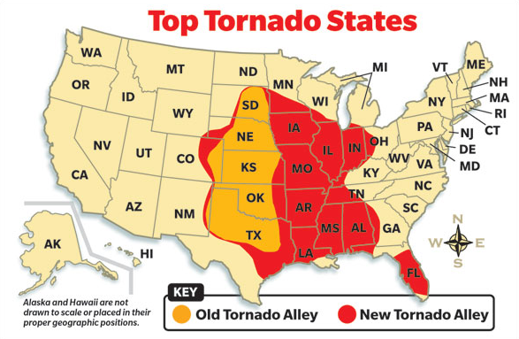
TCDS Weather Now April 12, 2017
A tornado, where?
At 2pm yesterday, a small tornado began forming in the city of Marana, just North of Tucson. Witnesses reported seeing the pendant form from one of the larger cummulo- nimbus clouds, often familiar with monsoon clouds.
This unusual siting has left many a little worried as Arizona is far from Tornado Alley. So , what do we need to do to be safe? Most homes along Tornado Alley have basements for safety; however, the In Arizona the ground is very hard, making the feasability of house basements unlikely, and very expensive.
How to spot a tornado forming
Tornadoes are hard to predict, but for the avid storm tracker, it would be really helpful to have mobile radar system attached to your vehicle. For those not so bold and crazy, you can work in a ground based radar station to track storm movement and pendant formations.
Computer modeling is also used to help identify how tornadoes form and move across the lands, destroying neighborhoods, while leaving some homes almost untouched.
The three conditions necessary for a tornado are humidity, unstable air, and a lifting source. As the down draft circles from the clouds forming a pendant, it continues to move toward the ground causing the unstable air. When the updraft of warm air lifts off the ground, it moves inside the cyclone of the down draft, essentially squeezing up the updraft into a tornado.
How to stay safe
At home, one safety measure you can take is getting in your bathtub and place either a mattress or cushions above your head. At work school, you should move all the desks to the center of the room, away from any windows, and get under the desks.
In any case, stay away from windows and flying debris. Realistically, there is no safe place in a car. The only thing you can really do is drive away from it if you see it forming. Drive somewhere you can get inside for shelter.
Tornado Alley
Tornado Alley is literally the Heartland of America. Tornadoes are more likely to hit these areas than any where else in the United States, including Alaska and Hawaii. The main states include Texas, Oklahoma, Kansas, Nebraska, and South Dakota. More states have recently been added
Like warm water is fuel for a hurricane, Tornado Alley provides the necessary air and moisture conditions for a tornado to form. Peak months for Tornado season are March thru June. Storm trackers are less likely found outside of Tornado Alley because of the lack of tornadoes in those areas.
Fortunately, the tornado in Marana was short and only had minimal damage. As monsoon season seems to be more violent, we can only wonder if we should expect to see more tornadoes in Arizona.

